Slide 1
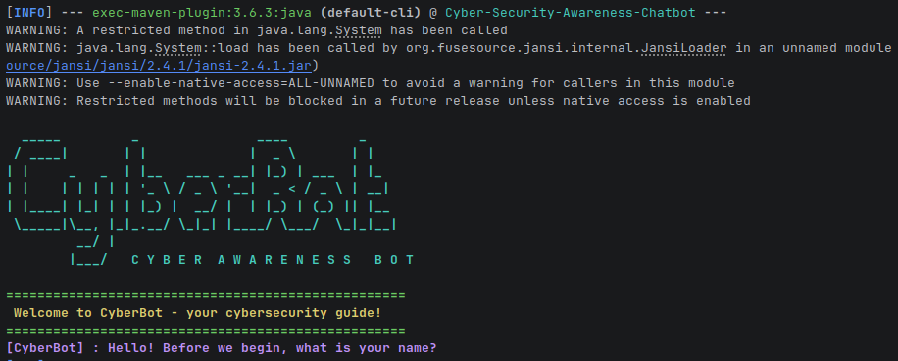
╔══════════════════╗
║ C Y B E R B O T ║
╚══ secure. learn. act. ══╝
PROJECT PROPOSAL · JAVA 17+
Cybersecurity Awareness
Chatbot (CyberBot)
Presented by Liyanda Tonisi
> boot cyberbot --awareness
[OK] knowledge base online
[READY] ask a security question_
CYBERBOT / INTRO
01

Slide 2
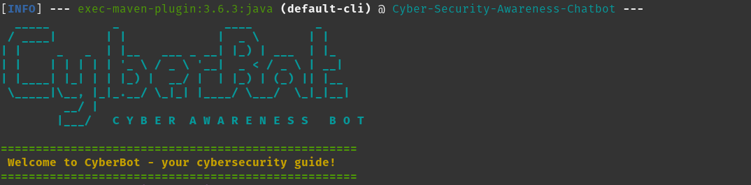
01 / THE PROBLEM
Threats move fast.
Awareness fades faster.
Traditional training
Everyday exposure
Long sessions. Dense slides. Low recall.
PHISHING / RANSOMWARE / MALWARE
WEAK PASSWORDS / PUBLIC WI-FI
CYBERBOT / AWARENESS GAP
02

Slide 3
02 / EXECUTIVE SUMMARY
Short answers.
Safer decisions.
$ java -jar cyberbot.jar
CYBERBOT > Hi Liyanda. What can I help you secure today?
YOU > How do I spot a phishing email?
CYBERBOT > Check urgency, sender details and unexpected links.
CyberBot is an interactive Java console app that delivers practical cybersecurity advice in plain language—without assuming a technical background.
CONVERSATIONAL
VOICE-ENABLED
OOP DESIGN
CYBERBOT / OVERVIEW
03

Slide 4
03 / USER EXPERIENCE
A terminal that
feels welcoming.
╔══ CYBERBOT ══╗
[voice] Welcome — let's stay secure.
> help
phishing passwords wifi
updates malware backup
> _
)))) )))) ))) )) )
Guided prompts · Dynamic help · Asynchronous greeting
CYBERBOT / INTERACTION
04

Slide 5
04 / HYBRID AI FLOW
Local first. AI when needed.
1 USER
QUESTION
2 LOCAL
KNOWLEDGE
3 AI
FALLBACK
4 SAFE
RESPONSE
Fast, varied local answers handle common topics. Niche questions fall back to Gemini 2.5 Flash; errors degrade gracefully, and approved responses can enrich the local knowledge base.
CYBERBOT / HYBRID INTELLIGENCE
05

Slide 6
05 / TECHNOLOGY STACK
Built with proven tools.
JAVA 17+
JANSI
FREETTS
> PLATFORM
> TERMINAL COLOUR
> VOICE
GEN AI SDK
MAVEN
JUNIT 5
> GEMINI 2.5 FLASH
> BUILD + RUN
> TESTING
CYBERBOT / STACK
06

Slide 7
06 / OOP ARCHITECTURE
Separated concerns. Clear ownership.
ENTRY
Main
CONVERSATION
Chatbot
User
ResponseEngine
TheBox
KNOWLEDGE
KnowledgeBase
AskAi
INTERFACE + SERVICES
ConsoleUI
HelpCentre
VoiceGreeter
CYBERBOT / ARCHITECTURE
07

Slide 8
07 / CORE FEATURES
Personality on the surface.
Resilience underneath.
ASCII + ANSI
Distinct terminal identity
VOICE GREETING
Approachable startup
LOCAL KNOWLEDGE
Varied security advice
DYNAMIC HELP
Guidance on demand
AI FALLBACK
Extended answers
SAFE COMMANDS
exit · quit · q
CYBERBOT / FEATURES
08

Slide 9
08 / SETUP + REQUIREMENTS
From clone to conversation.
REQUIRES
Java Development Kit 17+
Apache Maven 3.6+
Optional Gemini API key
01 CLONE REPO
02 SET API KEY
03 MVN BUILD
SUPPORTED
Pop!_OS · Ubuntu/Debian · macOS
Modern Windows terminals
04 RUN
CYBERBOT / SETUP
09

Slide 10
09 / RUN + TEST
One command to run.
One suite to trust.
TEST REPORT
────────────────────────
Chatbot behaviour PASS
Knowledge base PASS
Input validation PASS
────────────────────────
BUILD SUCCESS 0 failures
$ mvn compile exec:java \
-Dexec.mainClass=Main \
-Djansi.passthrough=true \
--enable-native-access=ALL-UNNAMED
CYBERBOT / VERIFICATION
10

Slide 11
10 / KNOWN LIMITATIONS
Graceful degradation
is a feature.
[WARN] FreeTTS may emit warnings on JDK 17+
→ voice falls back silently
[WARN] ANSI rendering varies by terminal
→ legacy Windows consoles may differ
[ OK ] Core chat remains functional without
voice synthesis or AI fallback
NO VOICE? NO AI?
CYBERBOT STILL WORKS.
CYBERBOT / LIMITS
11

Slide 12
11 / DEFENSIVE TOPICS
Learn the habits that reduce risk.
01
SPOT THE BAIT
02
PROTECT ACCESS
Phishing, social engineering and suspicious urgency.
Passwords, credentials and two-factor authentication.
03
SECURE THE PATH
04
RECOVER WELL
Firewalls, VPN safety and software updates.
Malware, ransomware, public Wi-Fi and backups.
CYBERBOT / CURRICULUM
12

Slide 13
12 / CONCLUSION
Secure learning,
one conversation at a time.
ACCESSIBLE ADVICE / MAINTAINABLE OOP / RESILIENT FALLBACKS / TESTED BEHAVIOUR
Thank you for your time.
Ready to see CyberBot live?
GPL-3.0 · OPEN COLLABORATION
CYBERBOT / LIVE DEMO
13

Slide 14
Q&A
What would you
like to explore?
?
Questions about CyberBot’s user experience, hybrid AI, architecture, testing or security topics are welcome.
> live_demo --available
CYBERBOT / QUESTIONS
14

